Slide 1
FATAL ACCIDENTS: Why did they happen?
Erik Dubec, Yang Yang, & ZiAng Zhang

Slide 2
Introduction
We present a data science study based on 33,000 fatal accidents that occurred in the US in 2015.
The purpose of our study is to find the possible factors that may lead to fatal accidents, including:
Geographical location
Age of the driver
Time (time in the year, day of the week, time of the day)
Weather

Slide 3
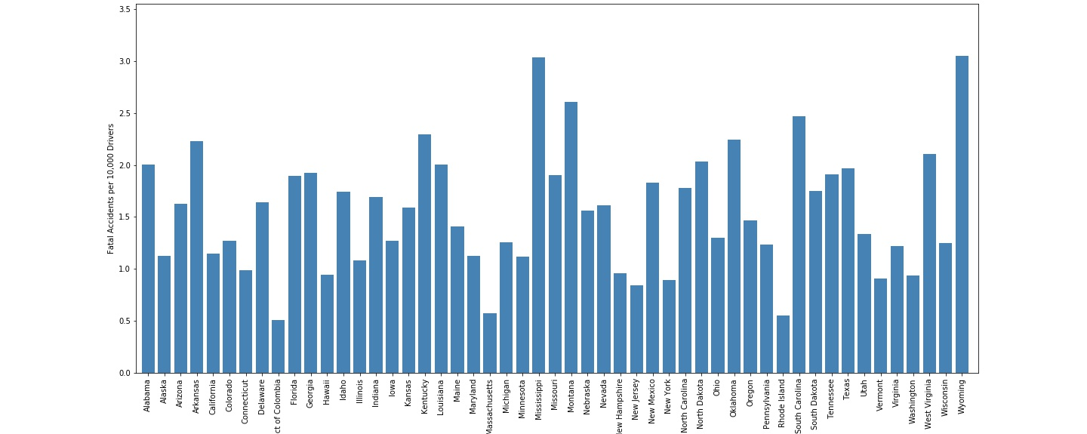
Accidents by state

Slide 4
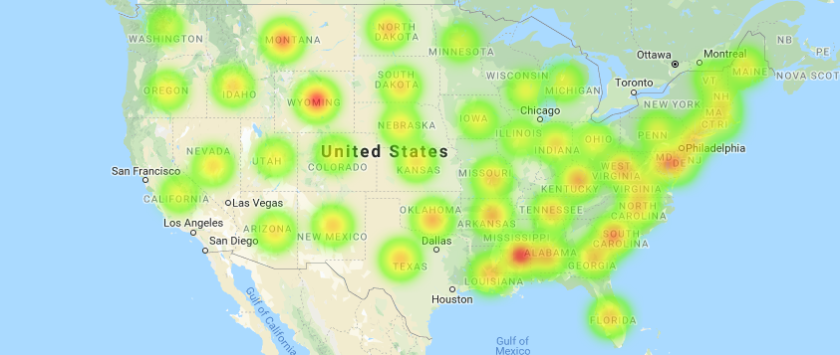
Heatmap

Slide 5
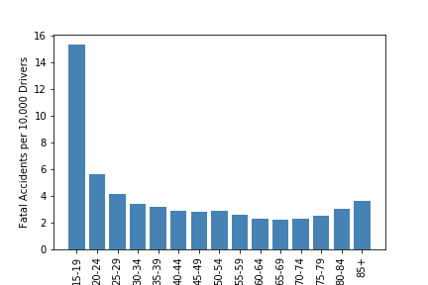
Age

Slide 6
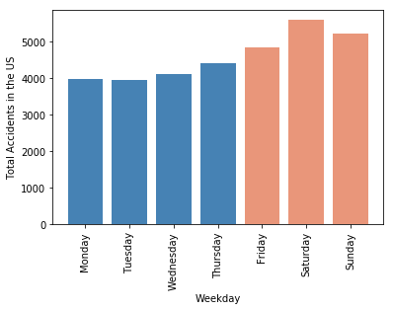
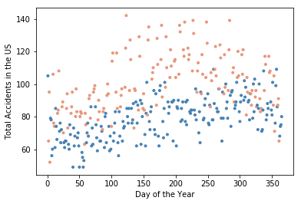
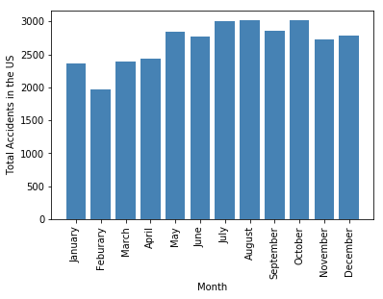
Time of the yearferences

Slide 7
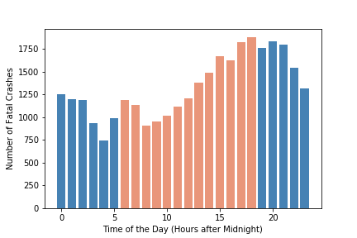
Time of the day

Slide 8
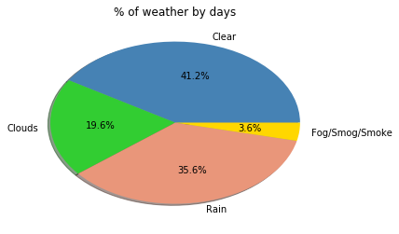
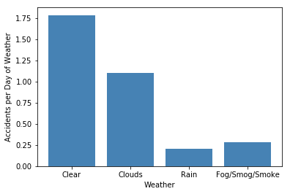
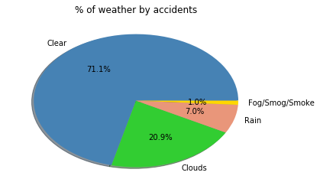
Weather

Slide 9
Comments
By geographical location:
Strong public transportation -> fewer fatal accidents?
Extreme weather -> more fatal accidents?
More data to establish link
By age: teenagers are dangerous
By time
Weekends are more dangerous than weekdays
The beginning of the year is slightly better
Evening commute is the worst
By weather: nice weather is more deadly!!

Slide 10
References
https://www.fhwa.dot.gov
https://maps.googleapis.com
https://openweathermap.org

